Slide 1
Image Processing Tool
A WPF application for loading, transforming, and saving images from a local folder.
Authors:
Miroslav Andonov
Yana Ivanova

Slide 2
Project overview
Built with .NET WPF, utilizes asynchronous and parallel programming.
Handles over 500 images efficiently (dataset: 716 bird images)
Core features:
Resize thumbnails (e.g., 128×128 → 64×64)
Convert to grayscale
Undo last 4 actions
Save to custom folder
Search/filter by name
Cancel long operations
Configure batch size

Slide 3
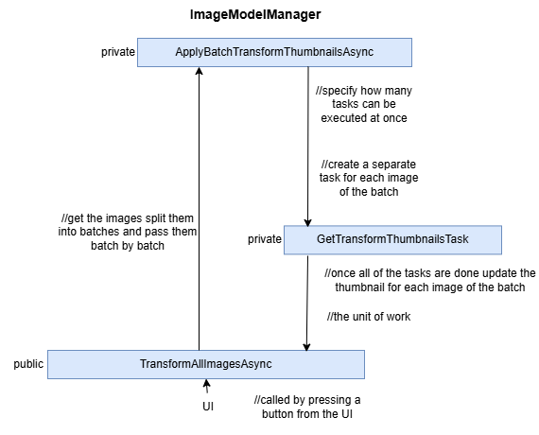
Processing pipeline
Core logic managed by ImageModelManager and its subclasses:
Load, Grayscale, Resize, and Save Managers
Batching limits memory usage (e.g., 32 images per batch)
Use Semaphore to control concurrency (2 x CPU cores)
Thumbnails updated using Dispatcher.InvokeAsync to remain UI-thread safe

Slide 4
Models, controls and search logic
ImageModel represents image state (name, path, bitmap, visibility)
Bound to ThumbnailControl UserControl with UI thread safety
Implements INotifyPropertyChanged for real-time UI updates
Search uses AsParallel() for responsive filtering
Batch size configurable via the Settings window and appsettings.json

